Slide 1

Salary Survey
Analysis-2021
Data Analysis – Milestone 1
By : Arun
DADS - July

Slide 2
Project Objective
The project evaluates a worldwide salary dataset encompassing various sectors, job categories, age brackets, and countries.
To identify the highest-paid jobs and top-earning industries based on the survey data.
Advanced analysis techniques in Excel, including Pivot Tables and dashboards, were applied to uncover trends and generate actionable insights

Slide 3
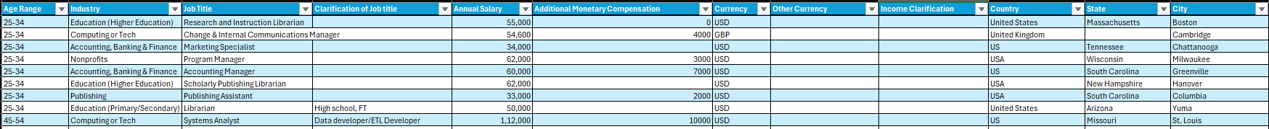
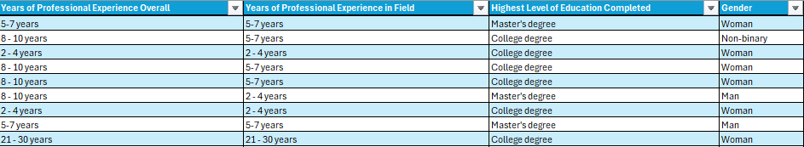
Dataset Overview
Total Records: 28,000
Number of Fields: 16
Key Attributes: Industry, Job Title, Gender, Country, Salary (USD), Experience, and Education Level
Data Source: Salary Survey Dataset
Business Purpose: To analyze global workforce compensation and assess the influence of experience, education, and gender on pay equity.

Slide 4

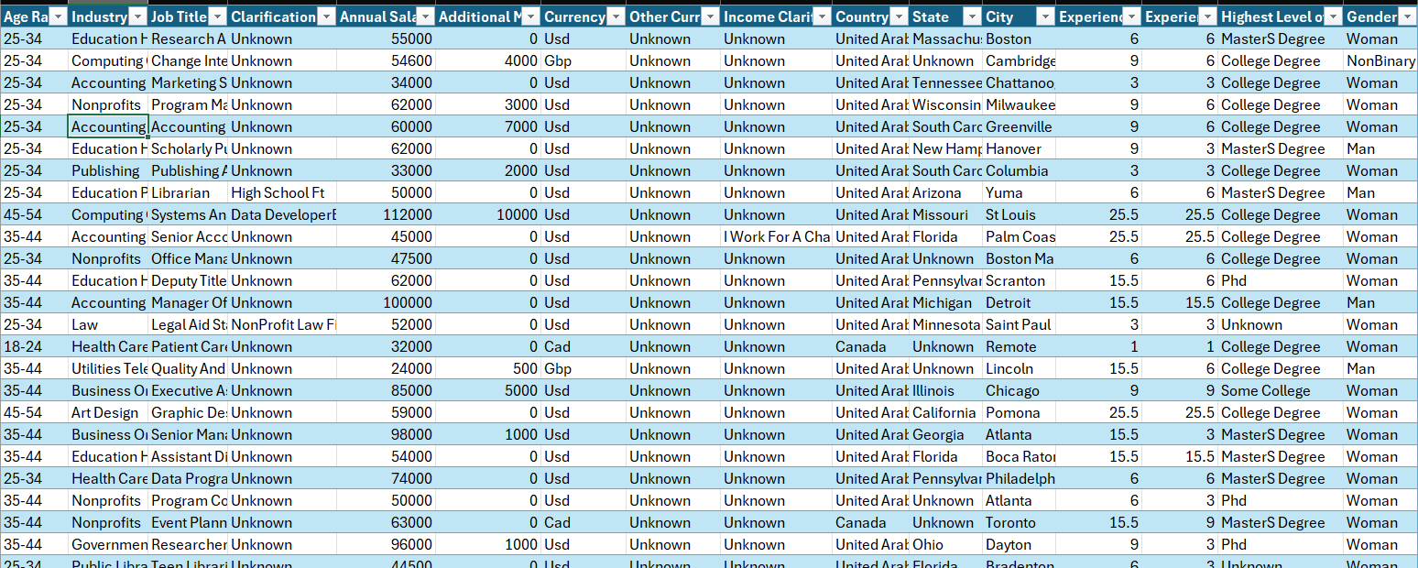

Data Cleaning
Removed missing and duplicate data.
Replacing the Missing Numerical values into “Median” and Categorical into “Unknown”
Standardized formats like currency and data types.
Spelling variations were corrected to avoid duplicate categories.
Capitalization was aligned to improve readability and consistency.
Prepared the cleaned data for analysis or MySQL use.

Slide 5

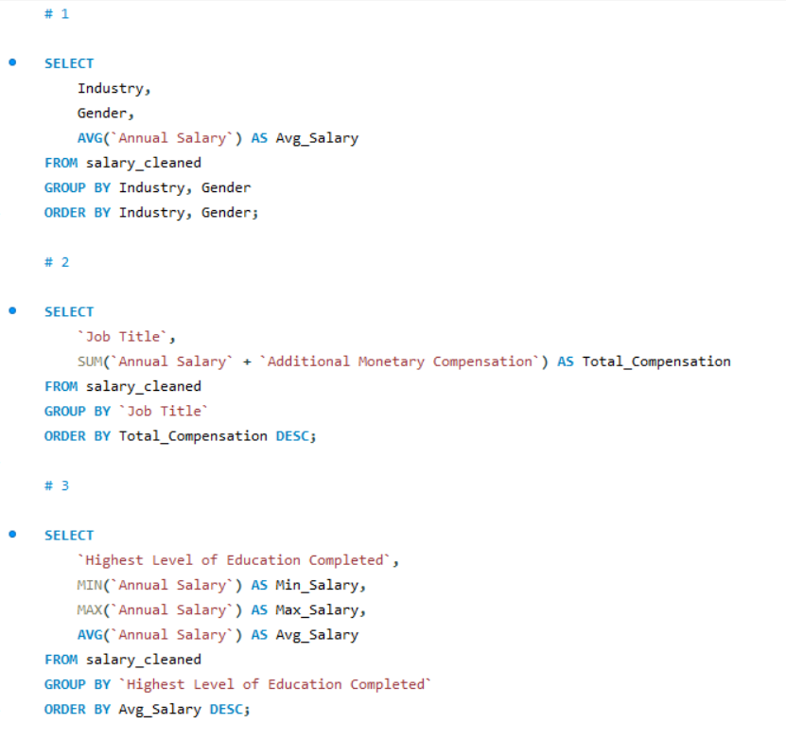

SQL Query
Ran all queries for salary, experience, gender, industry, job title, education & location.
Identified pay gaps, high-earning roles, and compensation trends.
Compared patterns to understand how salary changes across different factors.
Used results to build pivot charts and dashboards for insights.

Slide 6
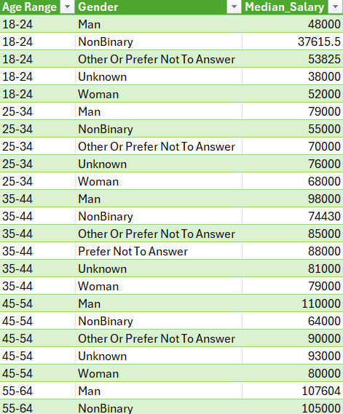
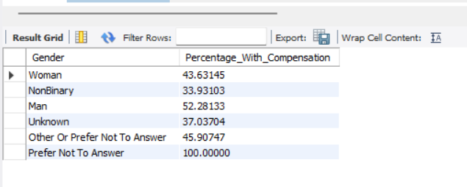
Export Queries to CSV File
I converted SQL data into a CSV file and used Excel to review and summarize findings

Slide 7
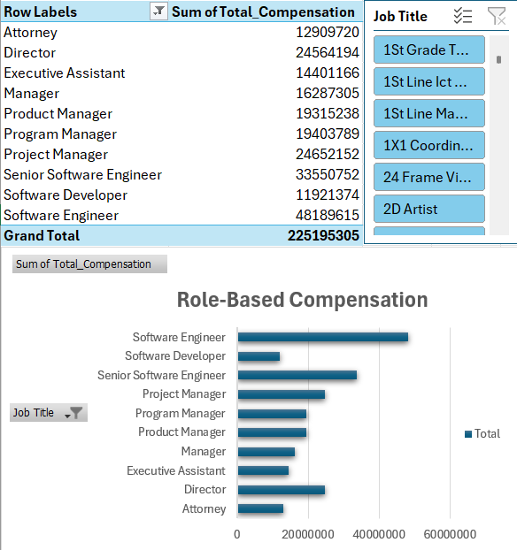
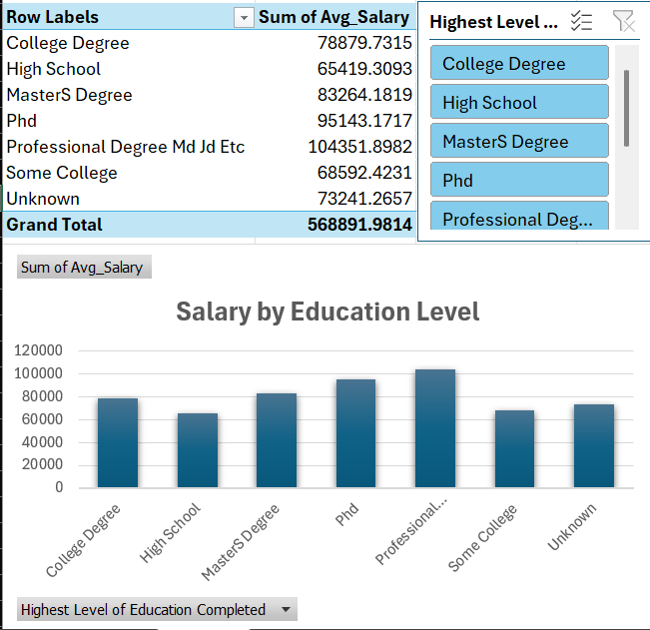
Pivot Table
I executed the SQL query, exported the results to Excel, and created a pivot table for analysis

Slide 8
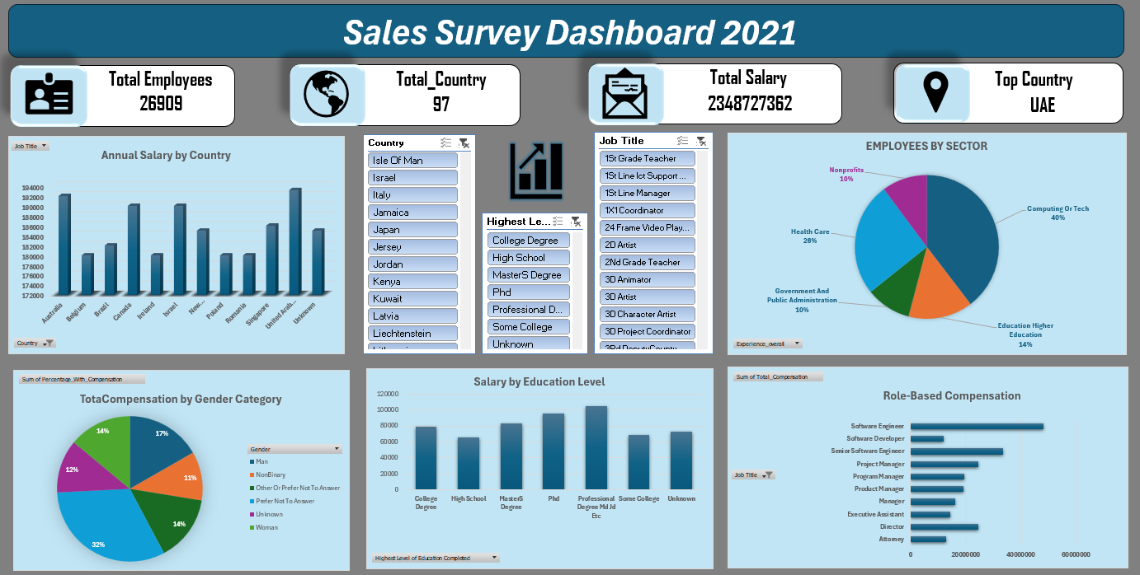
Dashboard

Slide 9
Key Insights
The tech industry pays the highest overall, contributing the biggest share to total earnings.
The survey is global and trustworthy, with responses from 97 countries and 27,000 people.
People with PhDs or professional degrees (like MD/JD) earn the highest salaries, usually over ₹1 lakh.
Experience and leadership roles make a big difference — the more senior you are, the more you earn.

Slide 10
Conclusion
The Salary Dataset Analysis provided valuable insights into how education level, experience, and industry significantly influence employee compensation.
Using SQL and Excel, salary patterns were analyzed across genders, job titles, and countries, revealing that higher education and greater experience lead to higher earnings.
The findings highlight the importance of data-driven HR decisions and support the need for fair pay structures and skill-based growth opportunities.

Slide 11
Thank You

